Slide 1
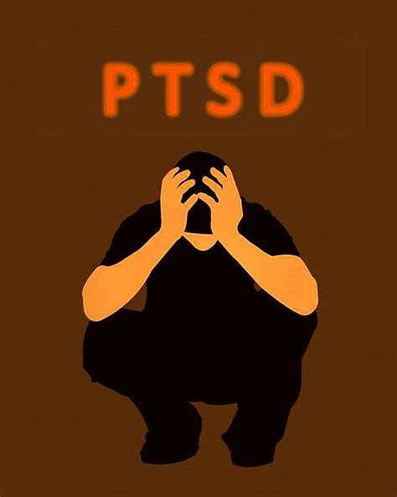
MDMA-Assisted Psychotherapy for Treatment of Post-Traumatic Stress Disorder (PTSD)
Presented By: Ashley Foo, Ismaeel El-Hakim, Rushabh Prajapati, Cameron Denney
and Katherina Sowinski

Slide 2
PTSD
Lifetime prevalence is between 6 and 10 percent in the United States of America
Diagnosis occurs after a traumatic event
Characterized by…
ahji, A et al. (2019). Elsevier, 1-15.

Slide 3
Currently Available Treatments
Pharmacotherapy
SSRI
Benzodiazepines
Psychotherapies
Prolonged exposure therapy
Cognitive processing therapy
Cognitive Behaviour Therapy (CBT)
Notes:
Talk about the drawbacks of each
Provide a general definition of psychotherapy

Slide 4
Introduction to MDMA and Literature Review
Effects of MDMA...
MDMA in conjunction with psychotherapy
Theory...

Slide 5
Introduction to MDMA and Literature Review
Case studies in the 1970s reported therapeutic effects
Gap:
Use of MDMA in clinical research has been sparse due to its scheduling of a class 1 controlled substance in the 1980s
Previous research determined that MDMA was safe for use in clinical trials

Slide 6
Proposed Study and Hypothesis
Based on five empirical research articles
Homogenous, phase 2, double-blind crossover clinical drug trials
Hypothesis...

Slide 7
Proposed study: Methods
PARTICIPANTS
N = 30 (14 men, 16 women)
Age range: 20-40 (M=29.3, SD=5.84)
Method of recruitment: posters in therapy offices, and referrals from doctors
Inclusion/Exclusion Criteria…
Notes:
A total of 30 participants (14 men and 16 women) will be recruited from social media advertisements. The participants will range from ages 20 to 40 years (M=29.3, SD = 5.84). The mean level of education was 3 years of post-secondary level education.
Participants will be recruited by referrals from healthcare professionals, and from advertisements placed in therapy offices in the province. The study will be reviewed by the University Ethics Review Board.

Slide 8
Proposed study: Methods
Primary Outcome Measure (Blake et al., 1995)
Clinician-Administered PTSD Scale IV (CAPS-IV)
Secondary Outcome Measure
Heart rate reactivity (PTSD symptoms)
Blood pressure, pulse, and temperature will be monitored during experimental sessions.

Slide 9
Proposed study: Methods
Procedure
Participants will be randomized into either the MDMA group or inactive placebo group (double-blind)
Doses (125mg MDMA or inactive placebo) will be administered at the beginning of 2 8-hour psychotherapy sessions.
Cross-over (not included in data analysis)
2-month follow-up
Variables
IV: Drug administered (MDMA or inactive placebo)
DV: CAPS-IV scores
Extraneous variables: type of psychotherapy used, setting where the therapy took place, etc.,

Slide 10
Results- Proposed analyses
Correlational model
Expected results (Rejected null hypothesis)
Strong negative correlation
Unexpected results (Failed to reject null hypothesis)
Small-moderate negative correlation
Positive correlation
No correlation

Slide 11
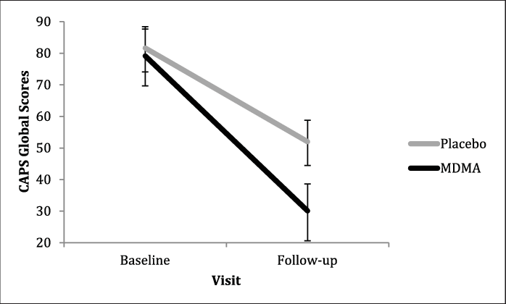
Results: Proposed Analyses
Example of expected findings: Placebo and MDMA-treatment Group Means Using CAPS-IV (Wagner et al., 2017).

Slide 12
Results: Proposed Analyses
Cohen’s d
Assess magnitude of treatment effect and whether clinical significance was observed
Expected results (rejected null hypothesis
0.8 or greater (large treatment effect)
Unexpected results (failed to reject null hypothesis)
Less than 0.8 (moderate to small treatment effect)

Slide 13
References
Baggott, M. (2000). Chemical Analysis of Ecstasy Pills. JAMA: The Journal of the American Medical Association, 284(17), 2190. https://doi.org/10.1001/jama.284.17.2190
Bahji, A., Forsyth, A., Groll, D., Hawken, E.R. (2019). Efficacy of 3,4-methylenedioxymethamphetamine (MDMA)-assisted psychotherapy for posttraumatic stress disorder: a systematic review and meta-analysis. Elsevier, 1-15.
Gamma, A. (2000). 3,4-Methylenedioxymethamphetamine (MDMA) Modulates Cortical and Limbic Brain Activity as Measured by [H215O]-PET in Healthy Humans. Neuropsychopharmacology, 23(4), 388–395. https://doi.org/10.1016/s0893-133x(00)00130-5
Gutner, C. A., Pineles, S. L., Griffin, M. G., Bauer, M. R., Weierich, M. R., & Resick, P. A. (2010). Physiological predictors of posttraumatic stress disorder. Journal of Traumatic Stress, 23(6), 775–784. https://doi.org/10.1002/jts.20582
Blake DD, Weathers FW, Nagy LM, Kaloupek DG, Gusman FD, Charney DS, Keane TM (1995) The development of a clinician administered PTSD scale. J Trauma Stress 8:75–90
Foa, E. B., Keane, T. M., Friedman, M. J., & Cohen, J. A. (Eds.). (2009). Effective treatments for PTSD: Practice guidelines from the International Society for Traumatic Stress Studies (2nd ed.). The Guilford Press
Mithoefer, M.C., Feduccia, A.A., Jerome, L., Mithoefer, A., Wagner, M., Walsh, Z., Hamilton, S., Yazar-Klosinski, B., Emerson, A., & Doblin, R. (2019). MDMA-assisted psychotherapy for treatment of PTSD: Study design and rationale for phase 3 trials based on pooled analysis of six phase 2 randomized controlled trials. Psychopharmacology, 236(0), 2735-2745.
Mithoefer, M.C., Mithoefer, A.T., Feduccia, A.A., Jerome, L., Wagner, M., Wyner, J., Holland, J., Hamilton, S., & Yazar-Klosinski, B. (2018). 3, 4-methylenedioxymethamphetamine (MDMA)-assisted psychotherapy for post-traumatic stress disorder in military veterans, firefighters, and police officers: a randomized, double-blind, dose-response, phase 2 clinical trial. Lancet Psychiatry, 5, 486-497.

Slide 14
References
Mithoefer, M.C., Wagner, M.T., Mithoefer, A.T., Jerome, L., & Doblin, R. (2011). The safety and efficacy of 3,4-methylenedioxymethamphetamine-assisted psychotherapy in subjects with chronic, treatment-resistant subjects with chronic, treatment-resistant posttraumatic stress disorder: the first randomized controlled pilot study. Journal of Psychopharmacology, 25, 439-452.
Rauch, S. L., Shin, L. M., & Phelps, E. A. (2006). Neurocircuitry Models of Posttraumatic Stress Disorder and Extinction: Human Neuroimaging Research—Past, Present, and Future. Biological Psychiatry, 60(4), 376–382. https://doi.org/10.1016/j.biopsych.2006.06.004
Ot’alora, M., Gigsby, J., Poulter, B., Van Derveer III., J.W., Giron, S.G., Jerome, L., Feduccia, A.A., Hamilton, S., Yazar-Klosinski, B., Emerson, A., Mithoefer, M.C., & Doblin, R. (2018). 3,4-methylenedioxymethamphetamine assisted psychotherapy for treatment of chronic posttraumatic stress disorder: a randomized phase 2 controlled trial. Journal of Psychopharmacology, 32, 1295-1307.

Slide 15
References
Stewart, S. A. (2005). The Effects of Benzodiazepines on Cognition. J Clin Psychiatry, 66(2), 9–13. https://pubmed.ncbi.nlm.nih.gov/15762814/
Wagner, M. T., Mithoefer, M. C., Mithoefer, A. T., MacAulay, R. K., Jerome, L., Yazar-Klosinski, B., & Doblin, R. (2017). Therapeutic effect of increased openness: Investigating mechanism of action in MDMA-assisted psychotherapy. Journal of Psychopharmacology, 31(8), 967–974. https://doi.org/10.1177/0
What is Psychotherapy? (n.d.). College of Registered Psychotherapists of Ontario. Retrieved November 25, 2020, from https://www.crpo.ca/what-is-psychotherapy/

Slide 16
D.Blake, D. D., Weathers, F. W., Nagy, L. M., Kaloupek, D. G., Charney, D. S., & Keane, T. M. (1998, July). CLINICIAN-ADMINISTERED PTSD SCALE FOR DSM-IV. Indiana University Bloomington. https://ipgap.indiana.edu/documents/ptsd_intruments/caps-instrument.pdf
J., King, L. A., & Nichols, D. E. (2013). Effects of Schedule I drug laws on neuroscience research and treatment innovation. Nature Reviews Neuroscience, 14(8), 577–585. https://doi.org/10.1038/nrn3530

